Slide 1





Seamless ML Workflows: Integrating Machine Learning with Event-Driven Architectures
Nirmalmahesh Subramani | Kiran Ravichandran

Slide 2
Agenda
Typical ML Workflows
Why we need to Integrate ML with EDA
Key Components of Integration
Event Driven Architecture ( Design Patterns )
Request Response Model
Point to Point Model ( Queue )
Point to Point Model ( Router )
Orchestration
Amazon Image Classification Case Study

Slide 3
Short Story (Typical ML Workflows)

Slide 4
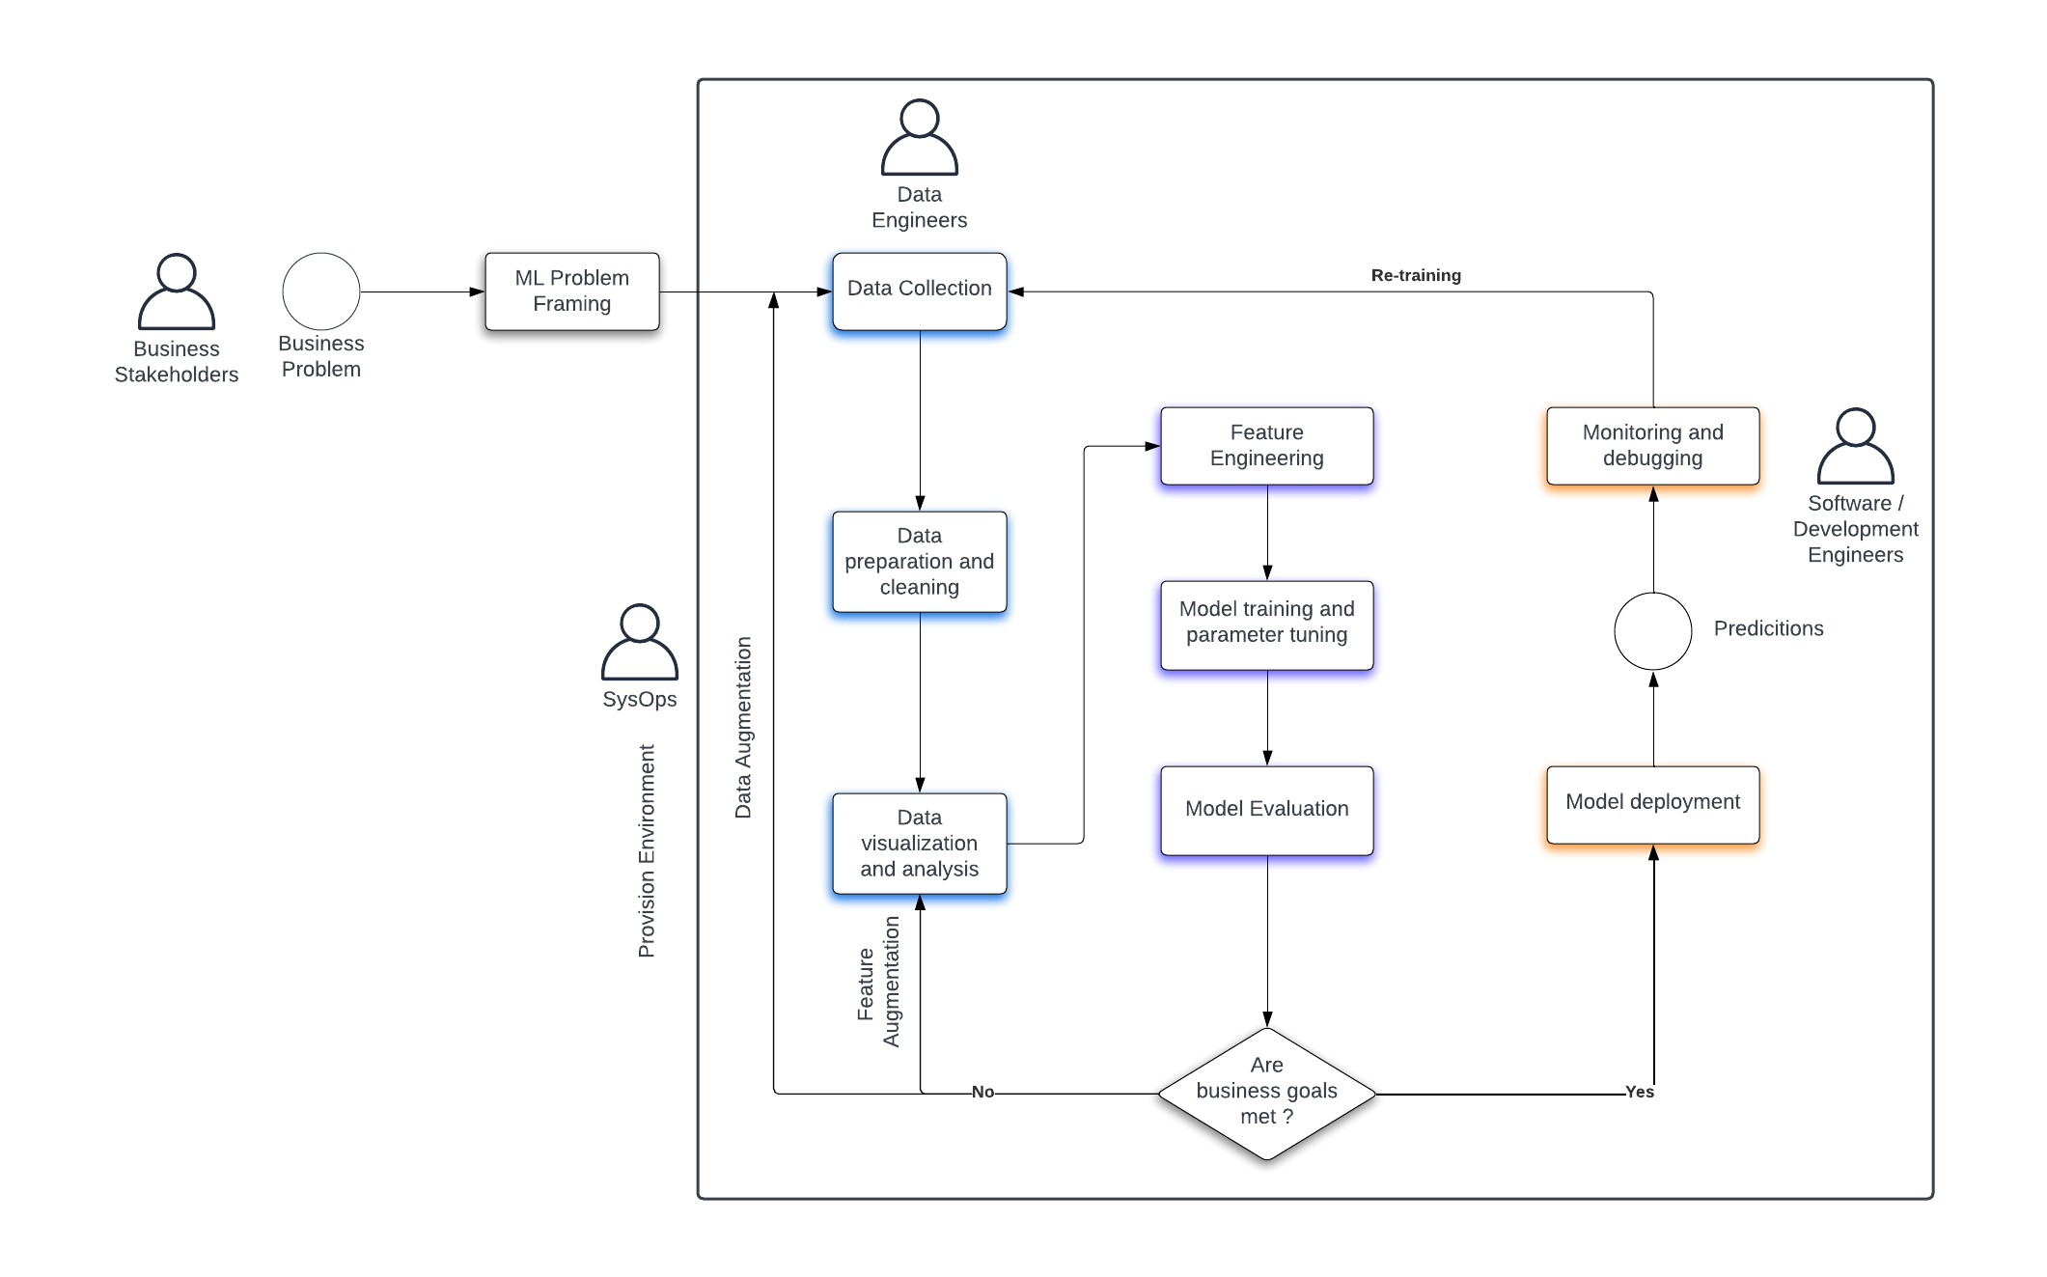
Typical ML Workflow

Slide 5
Why we need to Integrate ML with EDA ?
01
Real-time Data Processing and Decision Making:
02
Scalability and Flexibility
03
Improved User Experience
04
Enhanced Data Quality and Model Accuracy
05
Operational Resilience and Reliability
Notes:
Needs:
Fresh data is crucial for effective ML models.
EDAs enable real-time data ingestion and processing.
Synchronizing ML with EDAs ensures timely and accurate predictions.
Stale data compromises model accuracy.
Swift adaptation to data changes allows models to mirror current trends.
Benefits:
Adaptive Evolution: Models update with the latest data.
Optimized Engagement: Users receive timely insights.
Resource Efficiency: Smart computational allocation through event-triggered responses.
Reduced Latency: Quicker transition from data to insights.
Proactive Decisions: Enable businesses to act ahead of time.
Enhanced ROI: Up-to-date models yield superior predictions and returns.

Slide 6
Key Components of Integration
Event Sources
Data Streams
Event Processors
ML Orchestration Tools
Feedback Loop
Where the events originate. Eg. user interactions
Channels that allow continuous data ingestion, like Twitter stream or live transaction data.
Systems that react to and process these live streams
Control and manage the lifecycle of ML operations, such as training, deployment and monitoring.
Collect feedback for continuous learning.
1
2
3
4
5
Notes:
Event Sources: Where the events originate. E.g., user interactions.
Data Streams: Channels that allow continuous data ingestion, like Twitter streams or live transaction data.
Event Processors: Systems that react to and process these live streams.
ML Model Endpoint: Served using platforms like TensorFlow Serving, MLflow.
ML Orchestration Tools: Control and manage the lifecycle of ML operations, such as training, deployment, and monitoring.
Feedback Loop: Collect feedback for continuous learning.

Slide 7
Event Driven Architecture ( Design Patterns )

Slide 8
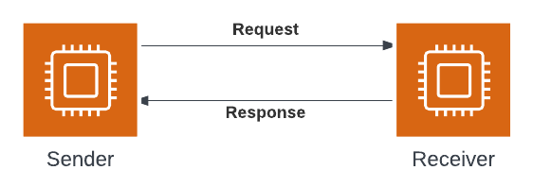
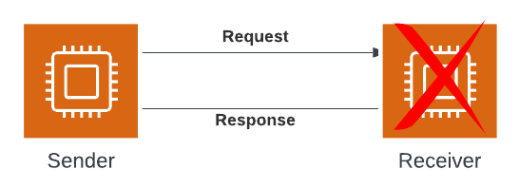
Sync Request Response Model
Advantages
Low Latency
Simple
Fail Fast
Disadvantages
Receiver Failure
Receiver Throttled

Slide 9
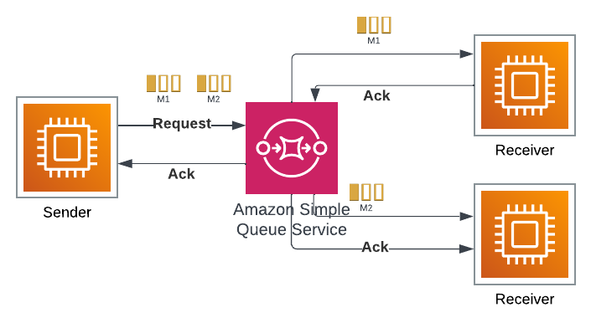
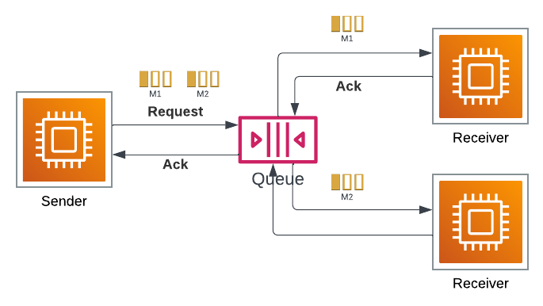
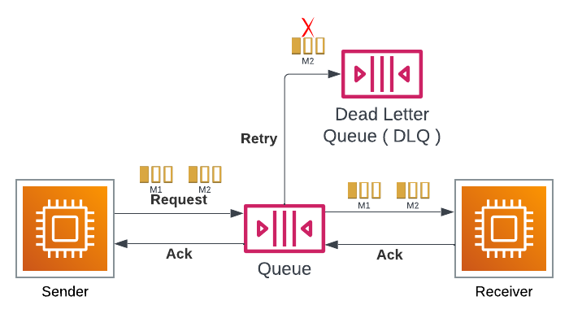
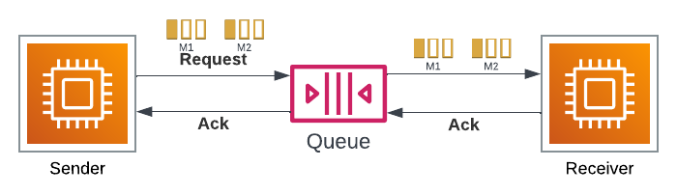
Asynchronous Point to Point Model ( Queue )
Advantages
Decreases temporal coupling
Receiver controls consumption rate
Dead Letter Queue for failures
Only one receiver can receive one message
Disadvantages
Response correlation
Backlog recovery time

Slide 10
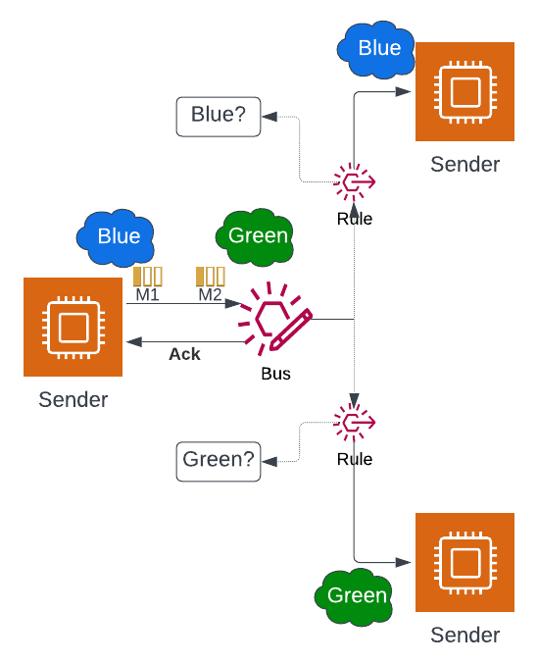
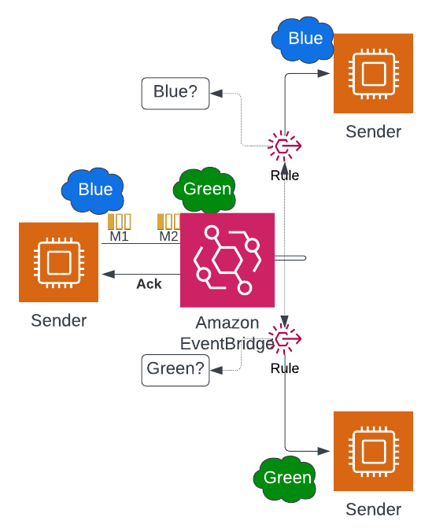
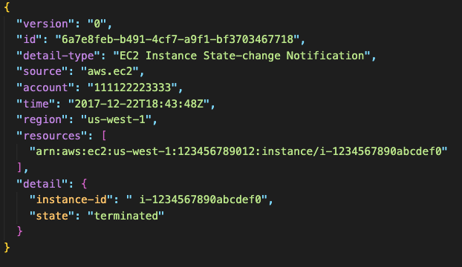
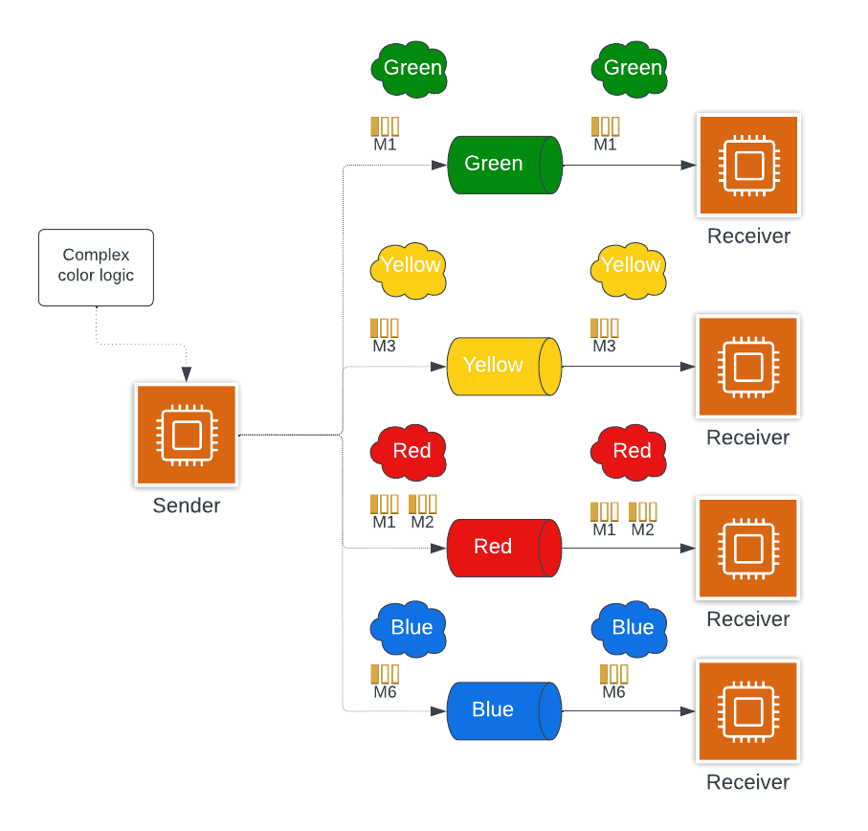
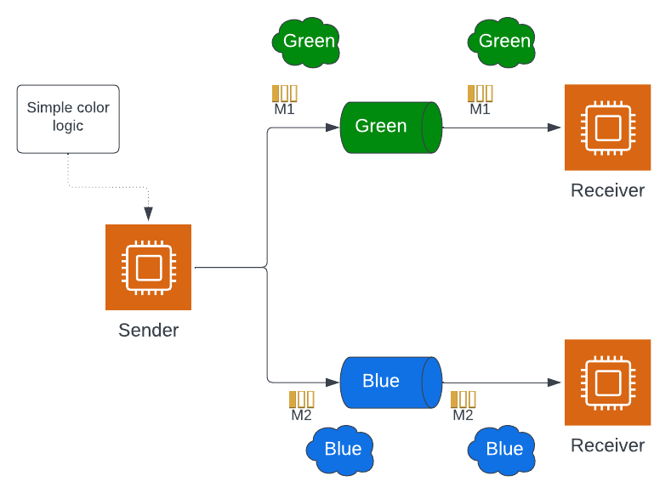
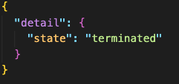

Asynchronous Point to Point Model ( Router )
Event Bus Event

Slide 11
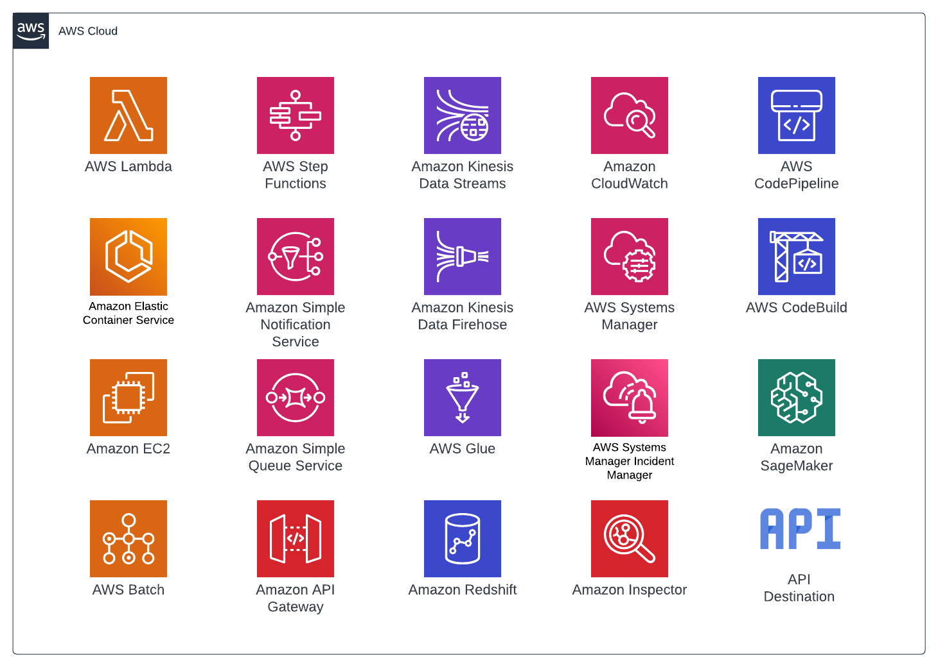
Event Bridge Support 20+ AWS services and API Destinations

Slide 12

Orchestration

Slide 13
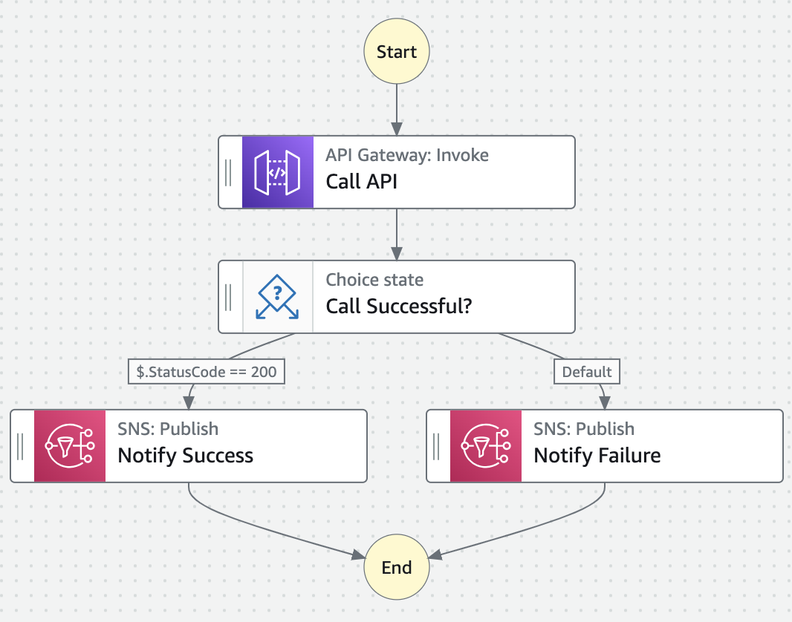
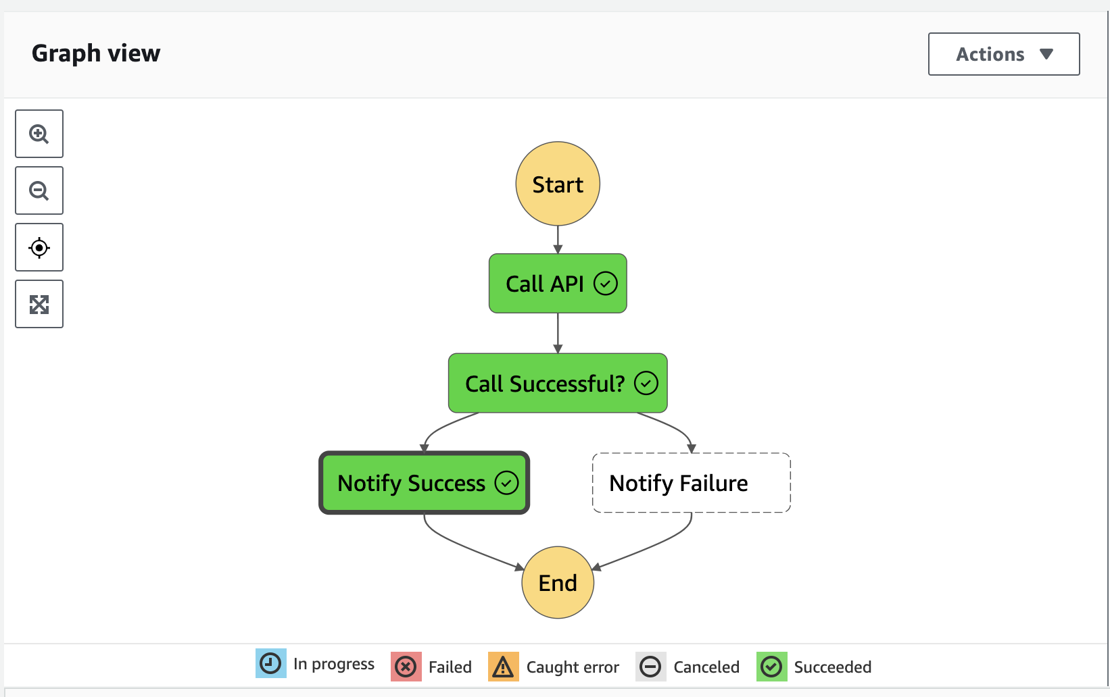
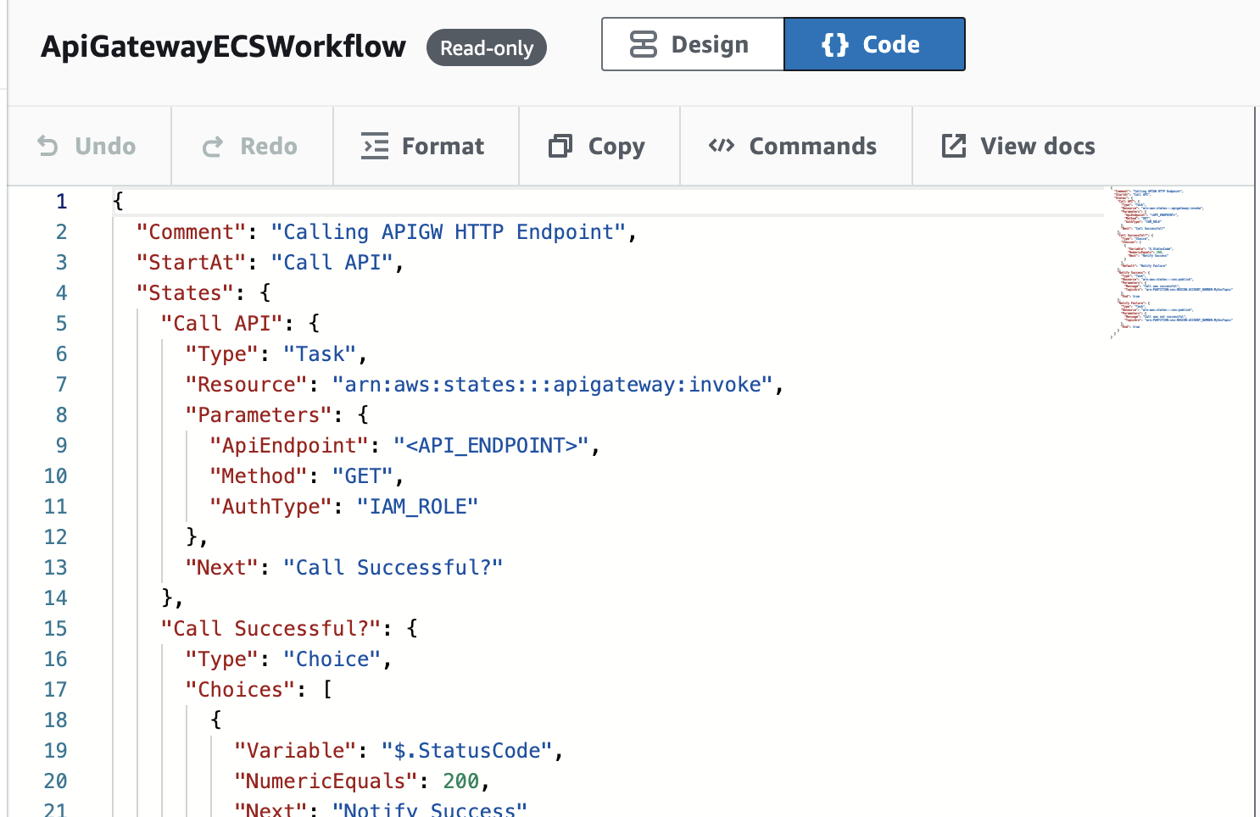
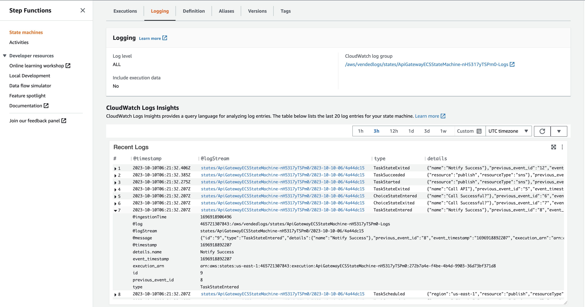

Step Function Visual Workflows
Define
Visualize
Execute and Monitor
JSON – Amazon States Language
CDK – JavaScript, TypeScript, Python,
C#, Java
Data Science SDK
Python

Slide 14
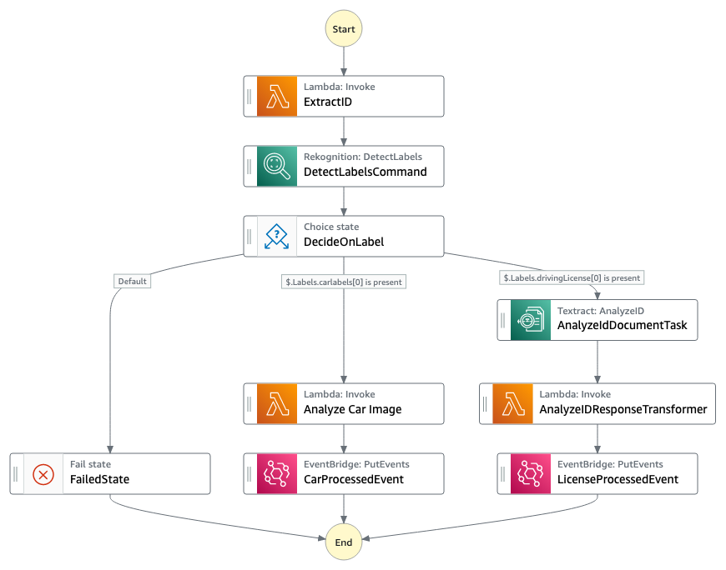
Sample ML Workflow Using Step Function
The workflows you build with step functions are called state machines and each step of your workflow is called state
When you execute your state machine, each move from one state from another state is state transition
You can reuse components, easily edit the sequence of steps, or swap out the code called by task states as your needs change

Slide 15
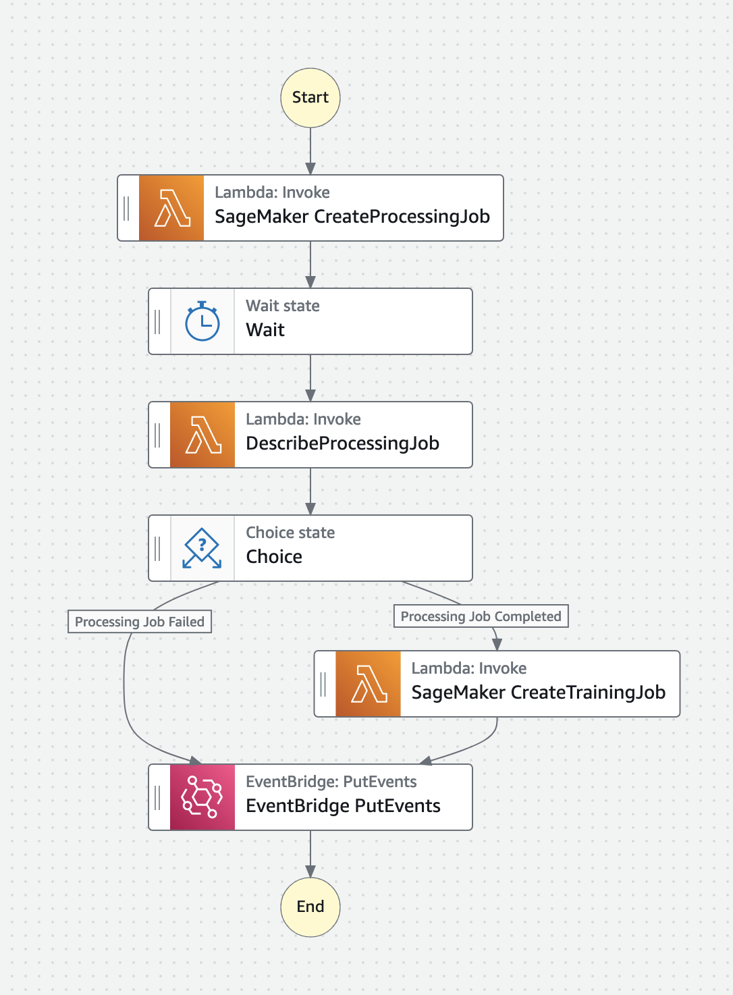
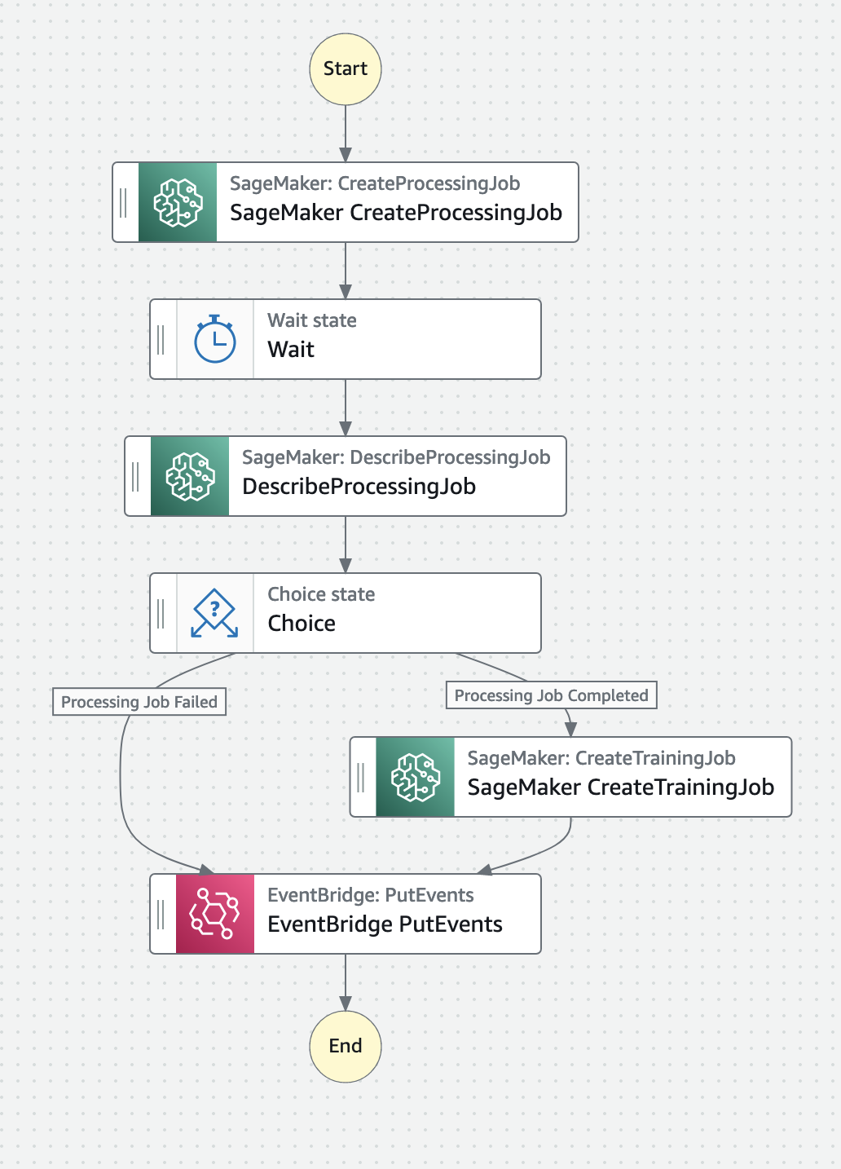

SageMaker Orchestration Using Step Function

Slide 16
Classifying Millions of Amazon items with Machine Learning
Amazon.com has more than 3 Million products that need to be classified every month across 38 countries, aligning with fluctuating local regulations.
This intricate challenge demanded an automated solution. Leveraging Amazon ML with Event Driven architecture has established a robust system to efficiently process these classifications.
Let’s see how scalable solution is built with AWS Lambda, Event Bridge, and Step Functions, ensuring data security using Amazon ML flows.

Slide 17
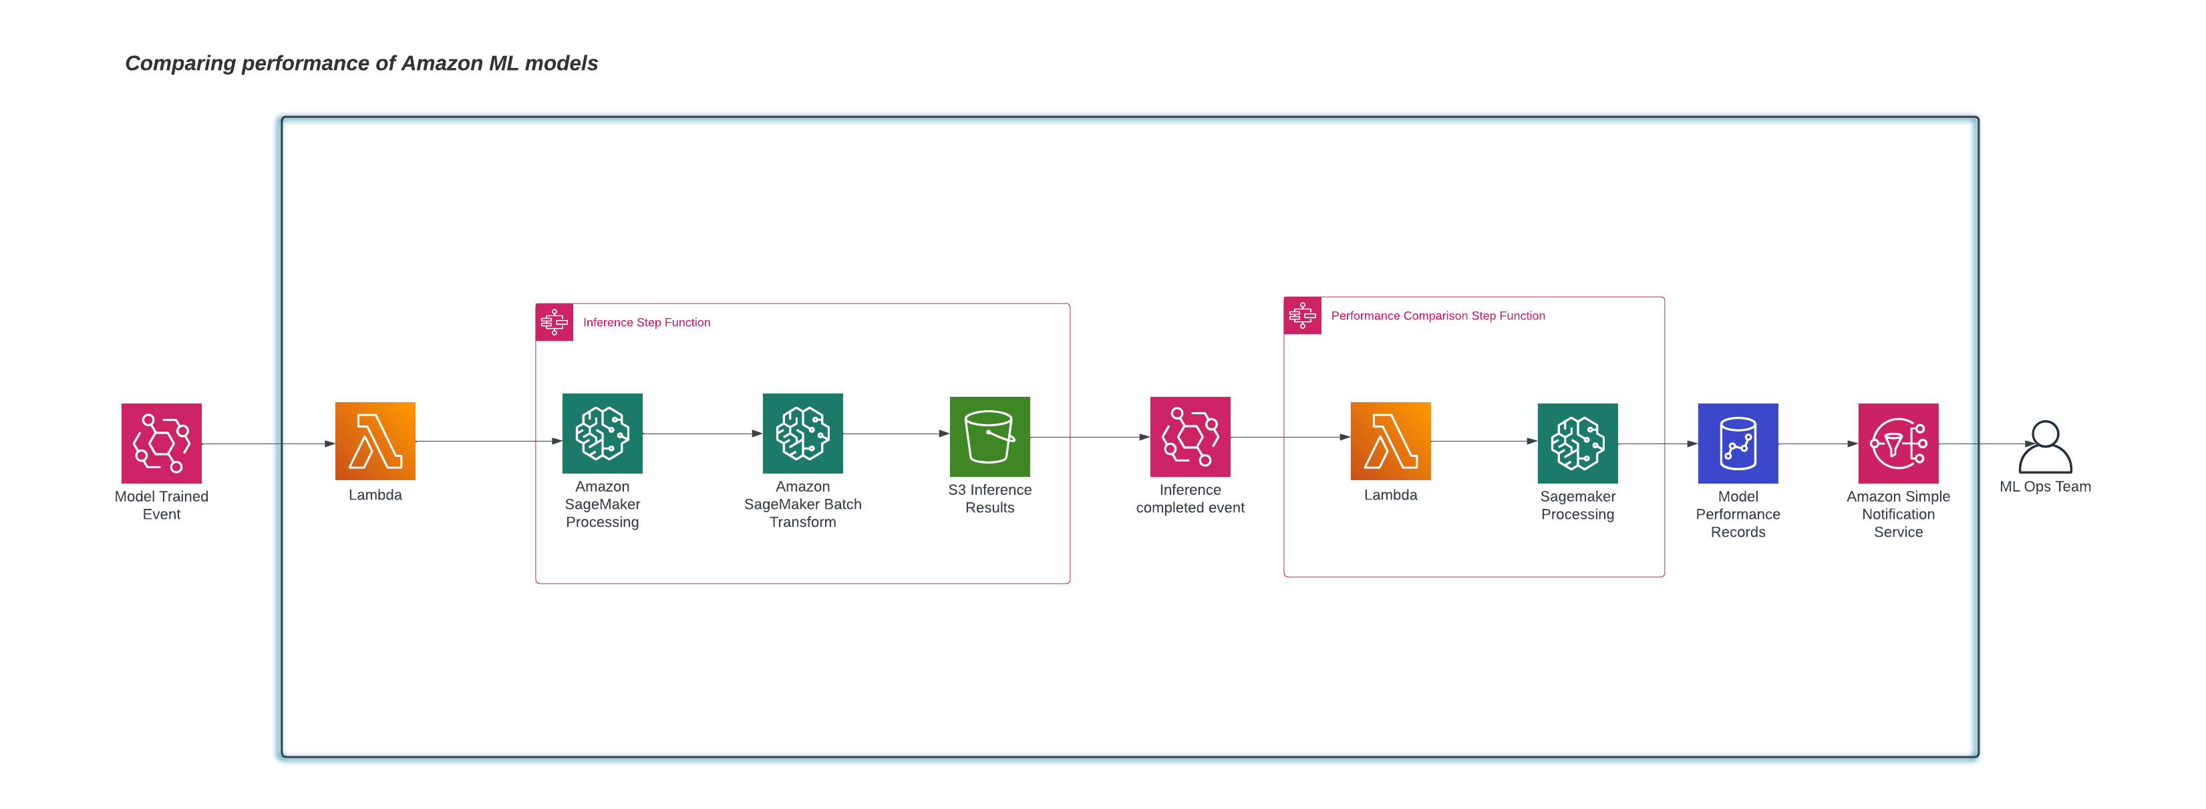
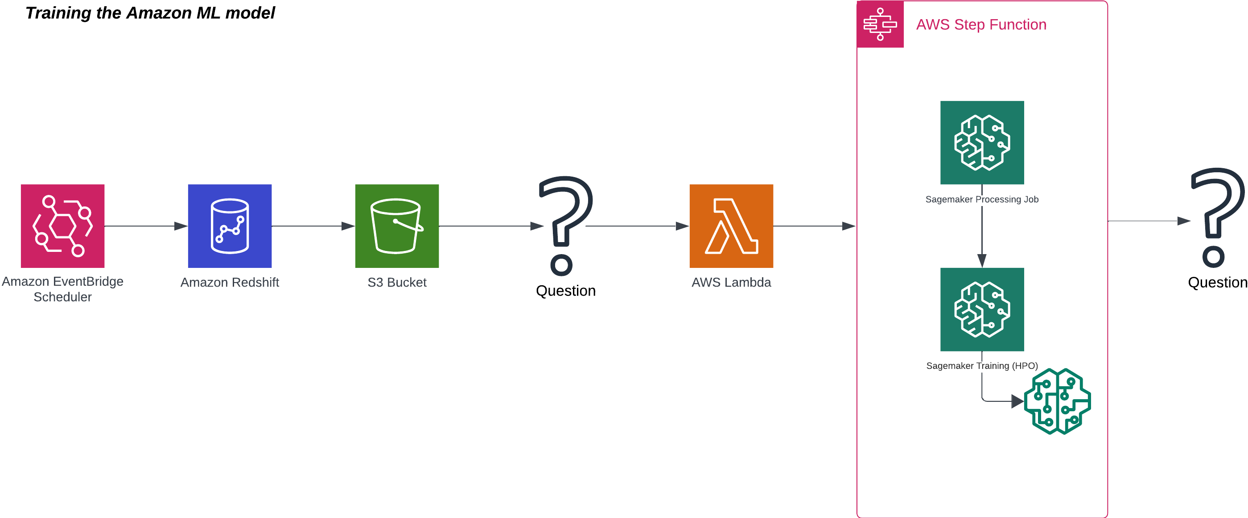
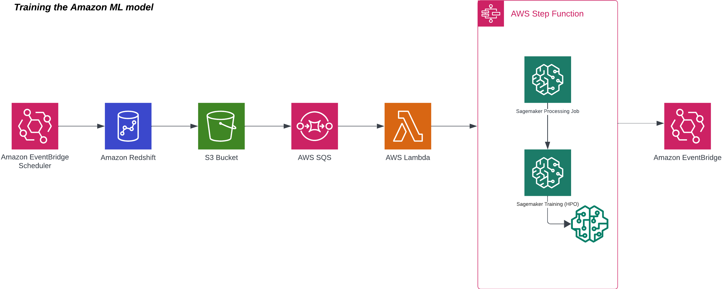
Classifying Millions of Amazon items with Machine Learning

Slide 18

Thank You
Nirmalmahesh Subramani
Lead Engineer, Presidio
nsubramani@presidio.com
Kiran Ravichandran
Lead Engineer, Presidio
kiran.r@presidio.com

Slide 19

Feedback
Your feedback is more valuable to us, Please scan this QR Code to provide feedback

